Slide 1
Cloud Security
Introduction & Overview

Slide 2
Agenda
What is cloud computing?
Cloud Application Infrastructure
How Cloud Application Works?
Data Security in a Cloud Application
Cloud OWASP Top 10
Cloud Application Attacks

Slide 3
What is Cloud Computing?

Slide 4
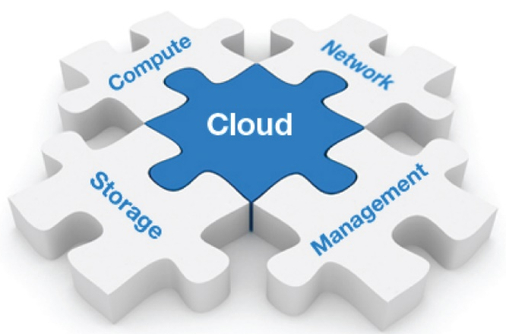
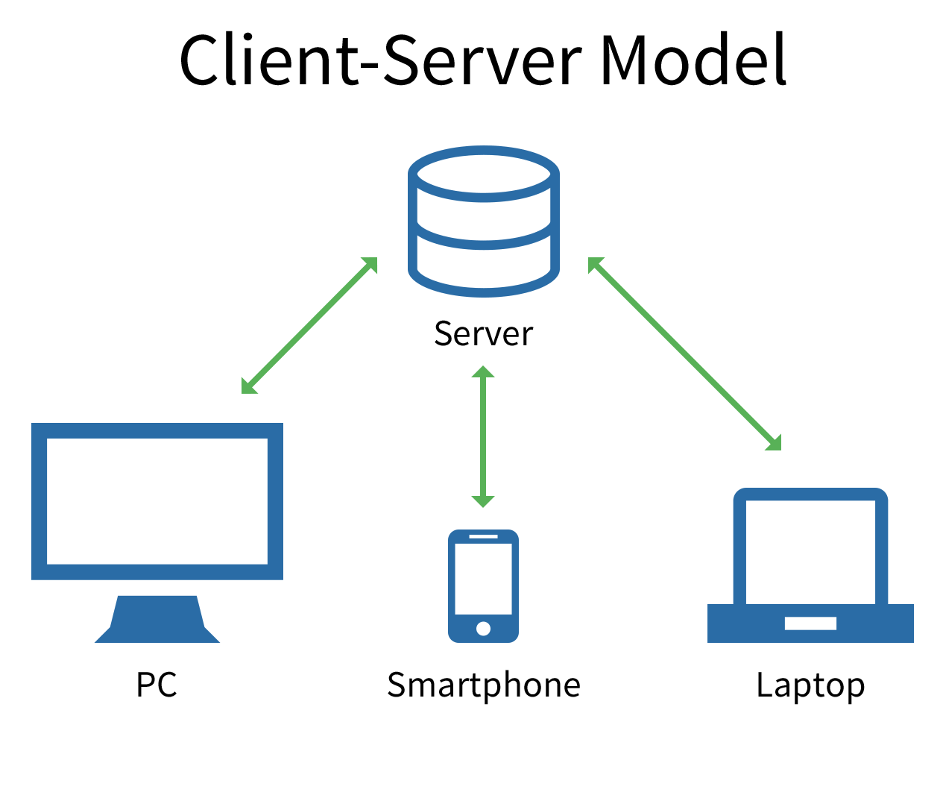
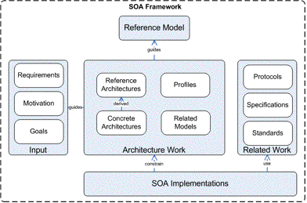
WHAT IS CLOUD COMPUTING?
Cloud computing is
The on-demand delivery of compute power, database storage, applications, and other IT resources through a cloud services platform via the internet
not an object in itself, rather it comprises services and database that are accessed via web or any private network
an information technology (IT) paradigm that enables ubiquitous access to shared pools of configurable system resources and higher-level services that can be rapidly provisioned with minimal management effort
1 of 5

Slide 5
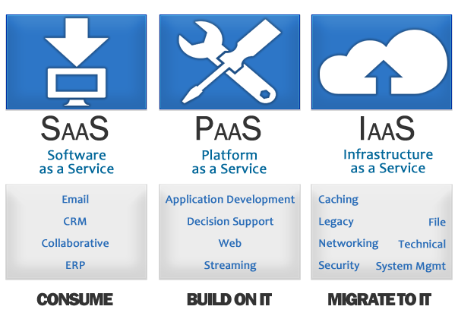
TYPES OF CLOUD APPLICATION
Cloud Application can mean many different things these days, but, there’s three main categories of cloud computing services.
You might have heard about these or use them already.
Software as a service (SaaS), for example – Microsoft 365;
Platform as a service (PaaS), example – salesforce.com;
Infrastructure as a service (IaaS), example – Rackspace.
2 of 5

Slide 6
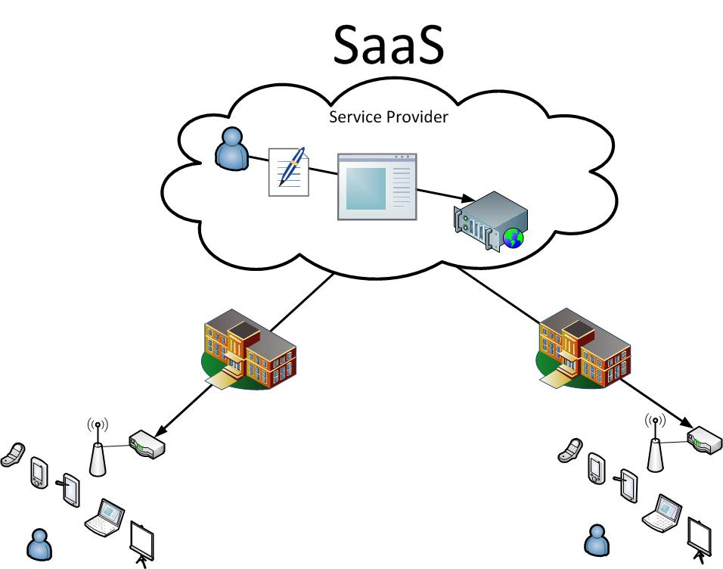
SOFTWARE AS A SERVICE
SaaS is an online platform where a service provider licenses various web apps to customers whenever there is a demand for it, which may also come via a subscription
It works using a pay as you go model, or for free
Web apps that run on SaaS model include Customer Relationship Management (CRM), email, online banking services, online data backup, Gmail, etc
3 of 5

Slide 7
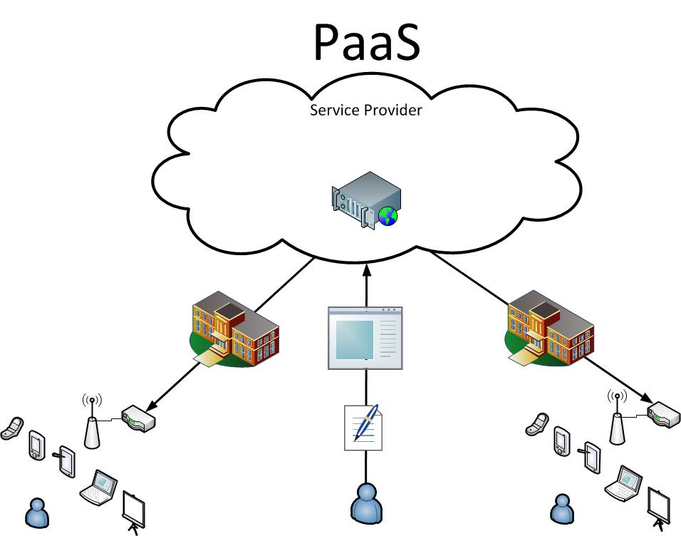
PLATFORM AS A SERVICE
Works best with software development purposes, PaaS offers a great environment for developers to design and build web applications easily
PaaS is particularly useful for software development businesses where multiple users, including external parties, need to collaborate on a project.
The platform is fully loaded with web features that a developer may need such as a user interface, multiple user facility, support for work collaboration, subscription tools, and other web services.
4 of 5

Slide 8
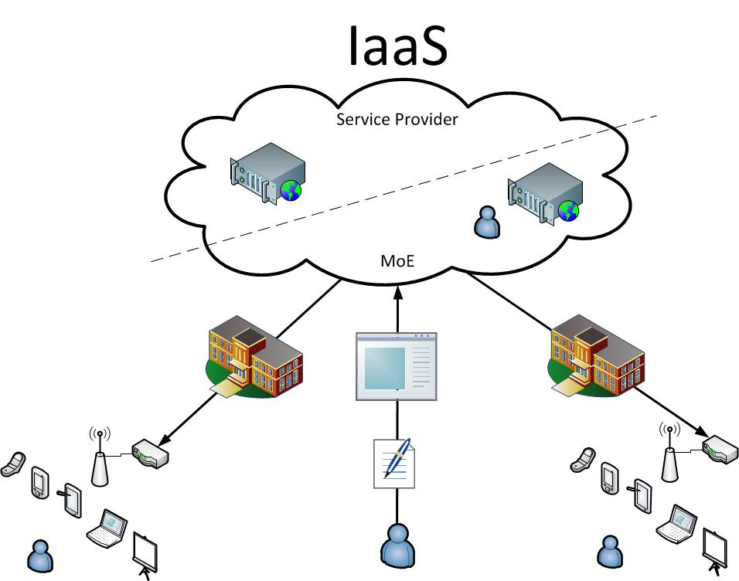
INFRASTRUCTURE AS A SERVICE
Things like networking, online storage, operating systems, and servers fall under the IaaS model. Businesses that may need to set up a full-service cloud computing infrastructure should get this service at one go.
Your business will thrive online as you cut labor costs (no need to deploy hardware stuff or a maintenance expert), streamline your scaling, and have more control over your ROI risks.
Few examples of businesses in IaaS include Microsoft, Red Hat, and Amazon.
5 of 5

Slide 9
Cloud Application Infrastructure

Slide 10
CLOUD APPLICATION INFRASTRUCTURE
Cloud infrastructure refers to the hardware and software components -- such as servers, storage, a network and virtualization software -- that are needed to support the computing requirements of a cloud computing model.
The components of cloud infrastructure are usually broken down into three categories:
Computing
Networking
Storage
These resources need to work together in order to provide a cloud service.
1 of 4

Slide 11
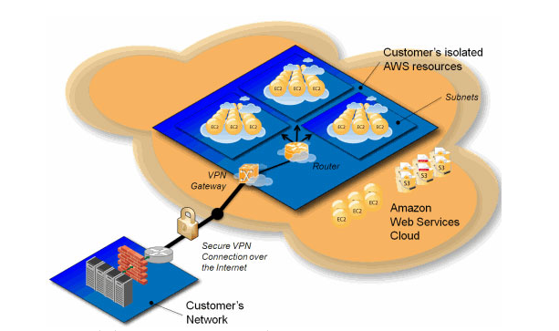
CLOUD APPLICATION INFRASTRUCTURE
2 of 4

Slide 12
CLOUD APPLICATION INFRASTRUCTURE
Computing: This part of the infrastructure, provides the computing power for the cloud service and is usually provided by racks of servers powered by server chips. The servers can be tied together with virtualization software, in order to, split up the computing power for different clients or services.
Networking: Routers and switches are used to move the data between the computing resources, the storage systems and the outside world. These might be proprietary data-center switches or white box switches running software-defined networking (SDN) software on commodity server hardware.
Storage: The cloud service usually requires large amounts of storage resources, which are often pooled and separated from the server hardware in separate racks, which might use a combination hard disks and flash storage. The storage systems have their own networking gear and storage software to manage high-performance connectivity with the service.
3 of 4

Slide 13
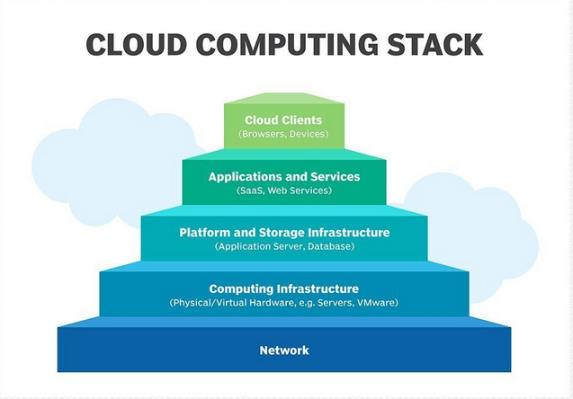
CLOUD APPLICATION INFRASTRUCTURE
4 of 4

Slide 14
How Cloud Application Works?

Slide 15
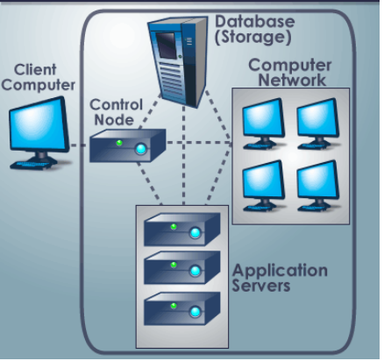
HOW CLOUD APPLICATION WORKS?
1 of 2

Slide 16
HOW CLOUD APPLICATION WORKS? (contd)
Data is stored and compute cycles occur in a remote data center, typically, operated by a third-party company.
A back-end server ensures uptime, security and integration and supports multiple access methods.
Cloud applications provide quick responsiveness and don't need to permanently reside on the local device. They can function offline, but can be updated online.
While under constant control, cloud applications don't always consume storage space on a computer or communications device.
Assuming a reasonably fast internet connection, a well-written cloud application offers all the interactivity of a desktop application, along with the portability of a web application.
2 of 2

Slide 17
Data Security in a Cloud Application

Slide 18
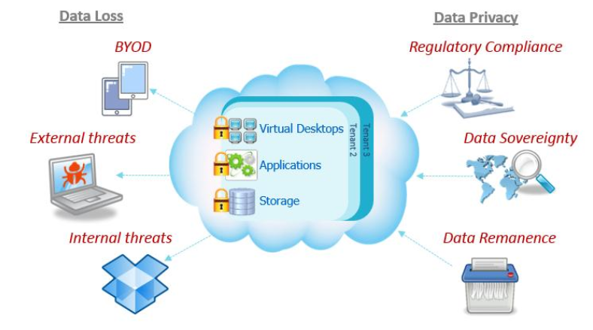
DATA SECURITY IN A CLOUD APPLICATION
1 of 9

Slide 19
DATA CONFIDENTIALITY
Data confidentiality is important for users to store their private or confidential data in the cloud. Authentication and access control strategies are used to ensure data confidentiality.
The data confidentiality, authentication and access control issues in cloud computing could be addressed by increasing the cloud reliability and trustworthiness.
The users do not trust the cloud providers. The cloud storage service providers are virtually impossible to eliminate potential insider threat, it is very dangerous for users to store their sensitive data in cloud storage directly.
Simple encryption is faced with the key management problem and cannot support complex requirements such as query, parallel modification and fine-grained authorization.
2 of 9

Slide 20
DATA INTEGRITY
Data integrity is one of the most critical elements in any information system. Generally, data integrity means protecting data from an unauthorized deletion, modification or fabrication.
Data integrity in the cloud system means, preserving an information integrity. The data should not be lost or modified by unauthorized users. Data integrity is the basis to provide cloud computing service such as SaaS, PaaS and IaaS.
Besides data storage of large-scaled data, cloud computing environment usually provides data processing service. Data integrity can be obtained by techniques such as RAID-like strategies and digital signature.
A large quantity of entities and their access points in a cloud environment means, an authorization is crucial in assuring, that only the authorized entities can interact with data.
3 of 9

Slide 21
DATA AVAILABILITY
Data availability means the following:
When accidents such as hard disk damage, IDC fire, and network failures occur, the extent that user’s data can be used or recovered and how the users verify their data by techniques rather than depending on the credit guarantee by the cloud service provider alone.
The issue of storing data over the trans-border servers is a serious concern of the clients because the cloud vendors are governed by the local laws, and therefore, the cloud clients should be cognizant of those laws.
Locating data can help users to increase their trust on the cloud. Cloud storage provides the transparent storage service for users, which can decrease the complexity of cloud, but it also decreases the control ability on data storage of users.
4 of 9

Slide 22
DATA PRIVACY
Privacy is the ability of an individual or group to seclude themselves or an information about themselves, and thereby, reveal them selectively.
In commerce, consumer’s context and privacy need to be protected and used appropriately. In organizations, privacy entails the application of laws, mechanisms, standards and processes by which personally identifiable information is managed.
In the cloud, the privacy means – when users visit the sensitive data, the cloud services can prevent potential adversary from inferring the user’s behavior by the user’s visit model (not direct data leakage).
5 of 9

Slide 23
SECURITY CHALLENGES
With more than 80 percent, the vast majority of enterprise businesses are now leveraging cloud environments, it’s no surprise that the infiltration of sensitive data into these environments
Cloud computing opens up a new world of opportunities for businesses, but mixed in with these opportunities are numerous security challenges that need to be considered and addressed prior to committing to a cloud computing strategy.
The challenges are divided into three main categories:
Data Protection
User Authentication
Contingency Planning
6 of 9

Slide 24
DATA PROTECTION
Implementing a cloud computing strategy means, placing critical data in the hands of a third party, so ensuring the data remains secure both at rest (data residing on storage media), as well as, when in transit is of paramount importance.
Data needs to be encrypted at all times with clearly defined roles, when it comes to, who will be managing the encryption keys.
In most cases, the only way to truly ensure confidentiality of encrypted data that resides on a cloud provider's storage servers is, for the client to own and manage the data encryption keys.
7 of 9

Slide 25
USER AUTHENTICATION
Data resting in the cloud needs to be accessible only by those authorized to do so, making it critical to both restrict and monitor, who will be accessing the company's data through the cloud.
In order to ensure the integrity of an user authentication, companies need to be able to view data access logs and audit trails to verify, that only the authorized users are accessing the data.
These access logs and audit trails additionally need to be secured and maintained for, as long as, the company needs or when the legal purposes require.
As with all cloud computing security challenges, it's the responsibility of the customer to ensure that the cloud provider has taken all necessary security measures to protect the customer's data and the access to that data.
8 of 9

Slide 26
CONTINGENCY PLANNING
With the cloud serving as a single centralized repository for a company's mission-critical data, the risks of having that data compromised due to a data breach, or temporarily made unavailable due to a natural disaster, are real concerns.
Much of the liability for the disruption of data in a cloud, ultimately rests with the company, whose mission-critical operations depend on that data, although liability can and should be negotiated in a contract with the services provider prior to commitment.
A comprehensive security assessment from a neutral third-party is strongly recommended as well.
Companies need to know how their data is being secured and what measures the service provider will be taking to ensure the integrity and availability of that data, when an unexpected event occurs.
9 of 9

Slide 27
Cloud OWASP Top 10

Slide 28
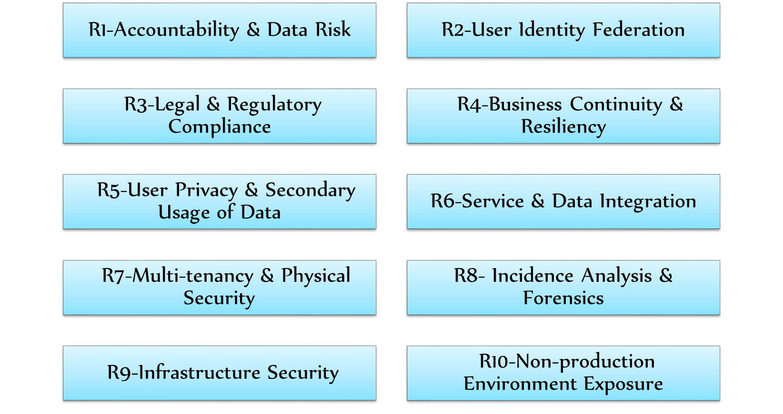
CLOUD OWASP TOP 10

Slide 29
R1 - ACCOUNTABILITY & DATA RISK
A traditional data center of an organization is under complete control of that organization.
The organization logically and physically protects the data it owns.
An organization that chooses to use a public cloud for hosting its business service loses control of its data.
This poses critical security risks that the organization needs to carefully consider and mitigate.
The lack of control will increase the risk of security of sensitive data.
In addition, most of the cloud service providers are using the multi-tenancy storage architecture, which allows multiple customers to store their data in one place.
There is a chance for cross data harvesting in case the storage architecture is not stable.

Slide 30
COUNTERMEASURES
The organization should be clear about the data recovering procedure of the providers to make sure the attackers should not be able to recover the deleted data in the cloud.
The provider should ensure proper backup process.
The provider should ensure the data is adequately isolated to avoid unauthorized access.
Data should be maintained in encrypted format both at rest and in transit.
The operator should use different encryption key for different user.

Slide 31
R2 - USER IDENTITY FEDERATION
If an organization is moving their services and application from one cloud provider to another, they should have proper control over their user credentials.
Instead of allowing the cloud providers to maintain identities causing authentication overhead to users, organizations are using user identity federation.
The approach involves SAML (Security Assertion Mark-Up language), an open source protocol that allows single sign-on across multiple cloud service providers.
It eliminates multiple identities allocated to an individual user.
It involves risk of the unauthorized access, in case the services allowing access to the user are improperly configured. Any attack on the SAML can allow the attackers to gain unauthorized access by stealing user credentials.
In addition, the single sign-on ability establishes the chances of a single point of failure.

Slide 32
COUNTERMEASURES
The organization should be clear on how the user identities & AAA (Authentication, Authorization & Accounting(+) protocols like SAML (Security Assertion Markup Language) are implemented.
The federation partners should follow the security policies and standards.
OAuth for back-end integrations.

Slide 33
R3 - REGULATORY COMPLIANCE
In cloud-based solution, data is stored at a random place. In most of the cases, customers are not even aware where they are hosted.
As different countries following different regulatory rules, the data that is supposed to be protected in one country is not supposed to be protected in another country.
The lack of transparency in the implementation, data owners find hard to demonstrate compliance.
There is also a lack of consistent standards as well as requirements for the global regulatory compliance.
For instance, the US patriot act provides no restrictions for the federal agencies to access the corporate data. On the other hand, the European Union possesses strict privacy laws, hence the data stored in the US as per the US compliance appear to be a compliance violation in Europe.

Slide 34
COUNTERMEASURES
To avoid compliance violation, the organization should make sure that their cloud service provider is storing their data in specific jurisdictions.
Ensure the provider made a contractual commitment in order to obey the local privacy requirements.
Apply risk management, define data protection requirements and SLAs, etc.

Slide 35
R4 - CONTINUITY & RESILIENCY
Business Continuity is an activity an IT organization performs to ensure that the business can be conducted in a disaster situation. In case of an organization that uses cloud, the responsibility of business continuity gets delegated to the cloud provider.
To achieve business growth, the organization should ensure that their business can be performed even in a disaster situation.
In cloud computing, it is essential to make sure that data will be available even at an unexpected event.
A recent report states that outages of most cloud services depict that 100 % availability may not be ensured. In cloud computing, the responsibility of business continuity and resiliency goes to cloud providers instead of the organization.
This will increase the chance of risk due to not providing appropriate business continuity when a disaster occurs.

Slide 36
COUNTERMEASURES
The organization has to make sure the RTOS (Recovery Time Objectives) are clearly defined in the contractual agreement.
Ensure the provider comprise approved business continuity policy in place
Verify that policy is certified or aligned with internationally recognized standards like BS25999.

Slide 37
R5 - USER PRIVACY & SECONDARY USAGE OF DATA
Data which uniquely identifies the individuals are no longer exist within the data center of the organization.
In addition, the data flows are global when it comes to cloud computing. There is more opportunity to deduct the privacy data of the user by the action of default share, for example via Twitter, LinkedIn, and Facebook.
The personal data are used or mined without consent. They can be transferred across the jurisdictional limitations. Lack of opt-out features for users, for example, they can’t delete data.
Lack of appropriate user control on enforcing appropriate user, protection and sharing of their personal information.

Slide 38
COUNTERMEASURES
The organization requires ensuring that their provider is not using their user’s privacy data for any secondary purpose.
Enforce policy for privacy & acceptable usage, consent and secondary usage.
Finalize the terms of service with cloud providers regarding the responsibility for compliance and geographical affinity.
Use encrypted storage.

Slide 39
R6 - SERVICE AND DATA INTEGRATION
Organizations must be sure that their proprietary data is adequately protected, as it is transferred between the end user and the cloud data center.
While the interception of data in transit should be of concern to every organization, the risk is much greater for organizations utilizing a cloud computing model, where data is transmitted over the Internet.
Unsecured data is susceptible to interception and compromise during transmission.
The security of data in transit should be a great concern to every organization. In the cloud computing solution, the data are transmitted between the end user and cloud data center.
While utilizing cloud, the transmission is carried over the internet, where there is an increase in risk for the organization. Like the traditional computing model, the transmission of secure data is vulnerable to interception and compromise.

Slide 40
COUNTERMEASURES
The provider must ensure that the data transferred between the end user and data center over the internet are appropriately protected.
They should ensure that they are using SSL or other stronger encryption protocols for securing data in transit.
Encryption.
Data in transit.

Slide 41
R7 - MULTI-TENANCY AND PHYSICAL SECURITY
Multi-tenancy in cloud means, sharing of resources and services among multiple clients(CPU, networking, storage/databases, application stack).
It increases dependency on logical segregation and other controls to ensure that one tenant deliberately or inadvertently cannot interfere with the security (confidentiality, integrity, availability) of the other tenants.
Most organizations prefer the cloud for the multi-tenancy feature, an they can share resources like networking, computing, storage, services as well as functionality related components.
In the multi-tenant environment, security dependencies are more on logical segregation instead of physical resource separation.
An inadequate logical security control, the chance of the presence of ignorance or malicious tenants and co-mingled tenant data enhances the security risk.

Slide 42
COUNTERMEASURES
The provider should mandate the architect for multi-tenancy along with consideration of logical segregation, single point of failure and strengthen common services.
They should provide transparency to tenants.
Should enforce well-planned change management and tenant isolation.
Make sure the tenants are provided with the proper knowledge on administrative access to their resources.
Employ regular third-party assessment.

Slide 43
R8 - INCIDENCE ANALYSIS & FORENSIC SUPPORT
When security breaches, policy violation or attack occurs, it is important to analyze that incident and conduct a forensic investigation.
The existing incident handling and forensics principle are commonly intended for the off-line investigation.
The evidence of the incident is likely to be stored in a place beyond the instant control of the investigator.
Since, the logging is distributed over multiple hosts and cloud data centers are placed in various countries, thereby governed by various laws, it is difficult to investigate the incident.
In addition, the multiple customers are storing the data in same shared hardware and data center, issues in law enforcement will arise during forensic recovery.

Slide 44
COUNTERMEASURES
Maintain comprehensive logging without any compromise in performance.
Employ enthusiastic forensic VM images.

Slide 45
R9 - INFRASTRUCTURE SECURITY
All infrastructure must be hardened and configured securely, and the hardening/configuration baselines should be based on Industry Best Practices.
Applications, systems and networks must be architected and configured with tiring and security zones, and access must be configured to only allow required network and application protocols.
Administrative access must be role-based, and granted on a need-to-know basis. Regular risk assessments must be done, preferably by an independent party.
A policy and process must be in place for patching/security updates, and can based on risk/threat assessments of new security issues.
Failure to keep the system and network device up-to-date might compromise the system security.

Slide 46
COUNTERMEASURES
Strengthen the applications, configuration and operating system to reduce the exploitability risk.
Isolate infrastructure component.
Employ tired solution architecture.
Enforce role-based administrative access and regular vulnerability assessments.

Slide 47
R10 - NON-PRODUCTION ENVIRONMENT
EXPOSURE
Organizations generally use non-production environment internally to design, develop and test their software or application.
This environment is not so much secure as like the production environment.
In the non-cloud environment, the organization includes complete control over the non-production environment. Hence, there is a minimum risk in security when compared to a cloud-based solution, where the non-production environment is beyond the control of the organization.
In cloud computing, there is a risk of malicious user accessibility in the non-production environment. This environment often includes generic authentication credentials which may not be align with the standard password policy of the organization, and hence, makes it effortless to achieve unauthorized access. With unauthorized access, attacker can make the environment useless or they can even delete it entirely.

